Slide 1
Neighbourhood Recommendation in a Borough in Toronto

Slide 2
Why is neighbourhood analysis important?
Safety and security concerns
Availability of daily utilities for households
Commute options availability for students and job holders
Community noise ratio for families looking to settle down permanently etc

Slide 3
Data Collection
Data is collected from the Wikipedia page where information about boroughs in Toronto is available along with the postal code and neighbourhood data.
Data source :
https://en.wikipedia.org/wiki/List_of_postal_codes_of_Canada:_M

Slide 4
Data Cleaning
Data scrapping is done using the pandas library in python to extract required information in the structured format for the analysis.
The structured data is the processed to filter out empty values and modified to fill empty cells with pre defined feature.

Slide 5
Data Collection
Data is collected from the Wikipedia page where information about boroughs in Toronto is available along with the postal code and neighbourhood data.
Data source :
https://en.wikipedia.org/wiki/List_of_postal_codes_of_Canada:_M

Slide 6
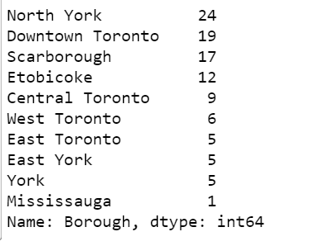
Boroughs in Toronto
The data on the rights depicts that there are in a total of 10 boroughs in Toronto.
“North York” borough has 24 neighborhoods, “Scarborough” borough has 17 neighborhoods, and so on.
Hence there are in a total of 10 boroughs and 103 neighborhoods in Toronto

Slide 7
Boroughs of interest
Scarborough
North York

Slide 8
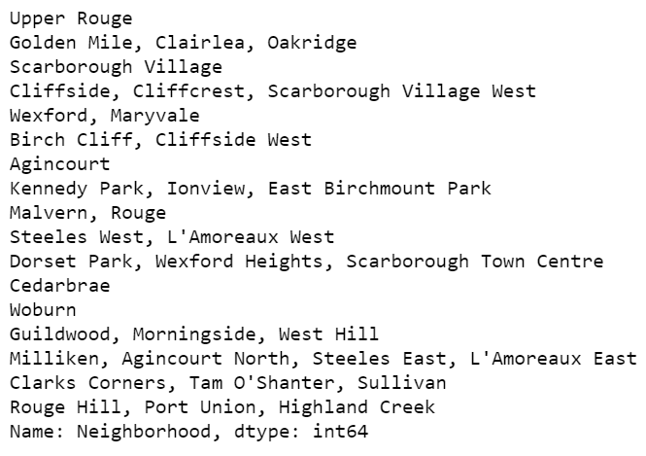
Neighbourhoods in Scarborough

Slide 9
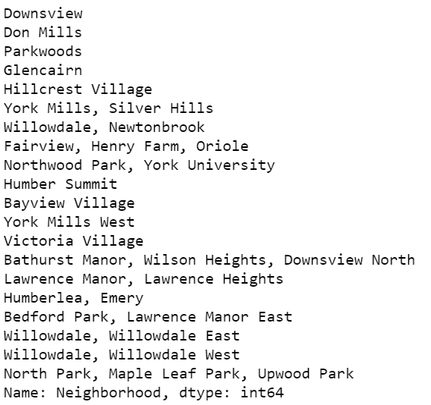
Neighbourhoods in North York

Slide 10
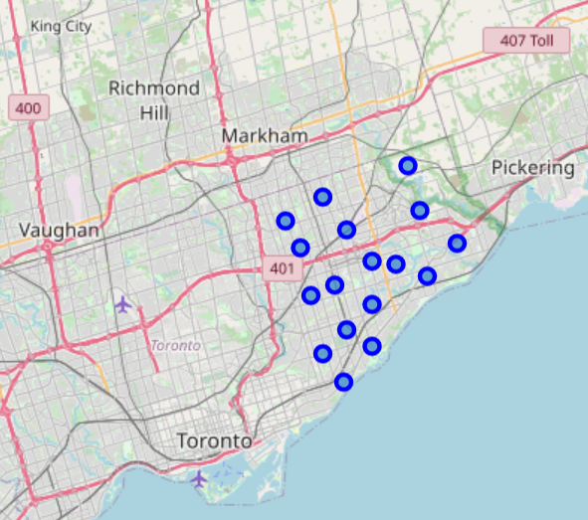
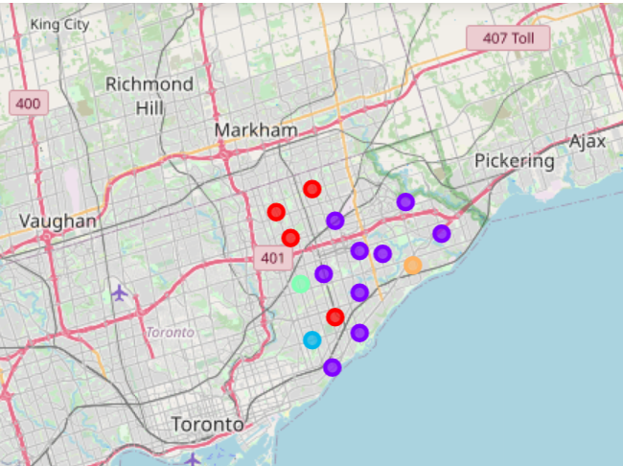
Scarborough Neighbourhood Analysis

Slide 11
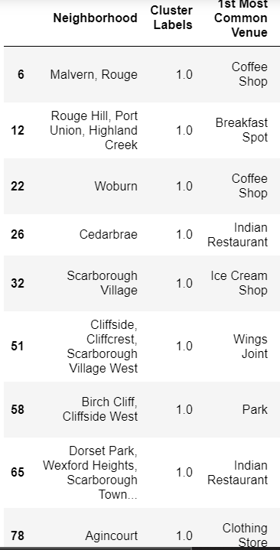
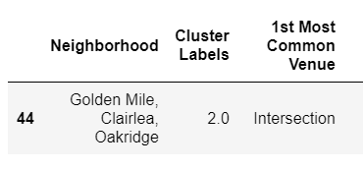
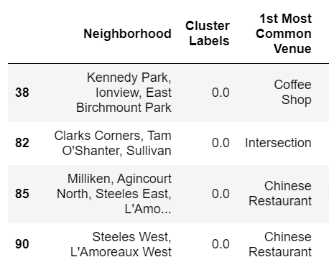
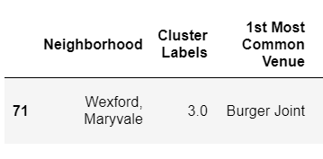
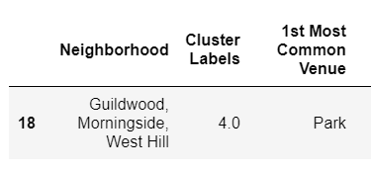
Scarborough Neighbourhood Characteristics

Slide 12
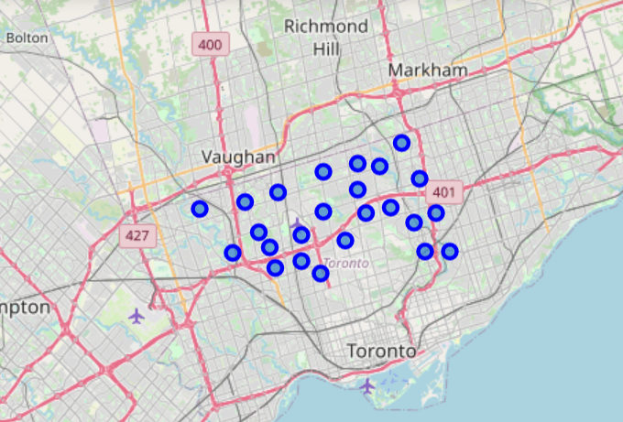
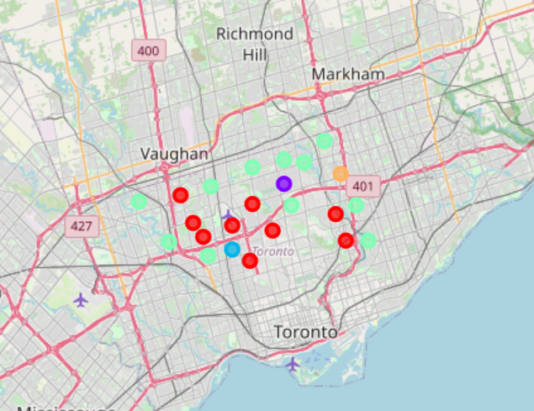
North York Neighbourhood analysis

Slide 13
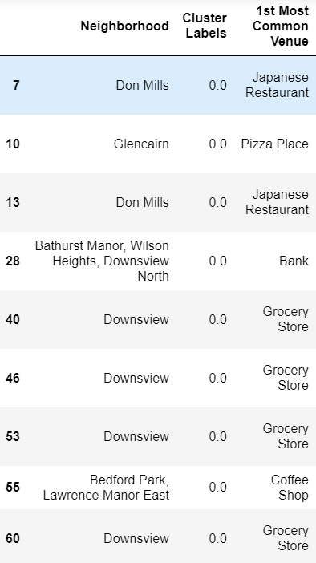
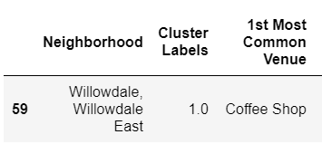
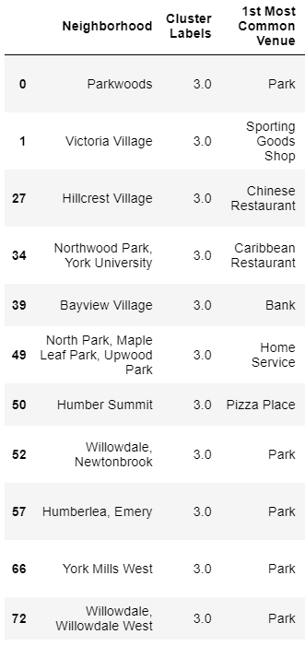
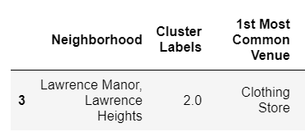
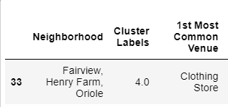
North York Neighbourhood Characteristics

Slide 14
Conclusion and future directions
Neighbourhood analysis amazingly helps an individual or a team to choose the right location for living based on personal or business needs.
As future work one can analyse all the neighbourhoods of the each borough in Toronto and mine the data to extract most salient features of each of the neighbourhood or groups of neighbourhoods in order to build a recommender system based on the selection criteria.

Slide 15
Thank
You

